Slide 1

Green Leaf Disease Detection using Raspberry pi
CVR COLLEGE OF ENGINEERING
DEPARTMENT OF COMPUTER SCIENCE AND ENGINEERING
Major Project
Batch No. 14
GUIDE :
Ms K.Manasa
Assistant Professor
Manasa Rajagopal Madabushi
18B81A05S2
Arakanti Maneesha
18B81A05S3
Liza Hans
18B81A05W2
Date Of Presentation : 9th May 2022

Slide 2
TABLE OF CONTENTS
INTRODUCTION
LITERATURE SURVEY
SOFTWARE AND HARDWARE SPECIFICATIONS
PROPOSED SYSTEM DESIGN
IMPLEMENTATION AND TESTING
CONCLUSION and FUTURE SCOPE
REFERENCES

Slide 3
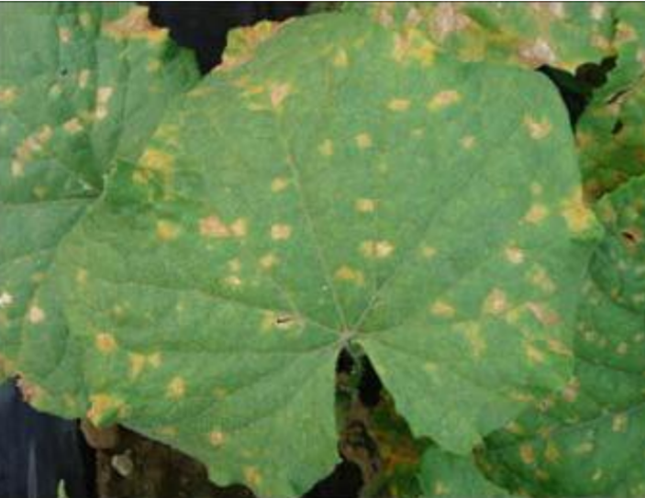
ABSTRACT
Fig 1:leaf spots
This project is about a framework utilizing raspberry PI to detect and prevent plant disease from spreading.
In pharmaceutical research, the recognition of leaf ailment is essential and a critical theme for research, because it has the advantages of monitoring crops in the field in the form and thus automatically detects symptoms of disease by image processing .
The term disease refers to the type of plant damage.
This project aims to use the strategy to recognizing plant infections utilizing picture preparing and alarming the ailment brought about by email and SMS .
Automatic detection of symptoms of disease is useful for upgrading agricultural products.
Completely automatic design and implementation of these technologies will make a significant contribution to the chemical application. The cost of pesticides and other products will be reduced. This will lead to an increase in farm productivity.

Slide 4
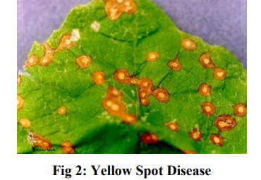
MOTIVATION
India is cultivated country and about 70% of the population depends on agriculture. Farmers have large range of diversity for selecting various suitable crops and finding the suitable pesticides for plant.
Disease on plant leads to the significant reduction in both the quality and quantity of agricultural product. The studies of plant disease refer to the studies of visually observable patterns on the plants. Monitoring of health and disease on plant plays an important role in successful cultivation of crops in the farm.
In early days the monitoring and analysis of plant diseases were done manually by the expertise person in the field. This requires tremendous amount of work and also requires excessive processing time.
The system uses raspberry pi to detect unhealthy leaves by training images.

Slide 5
PROBLEM STATEMENT
Develop an interface using Raspberry Pi using Green Leaf Detection the framework integrates the following components:
Raspberry Pi 3
Camera
GSM Module
Email Communication

Slide 6
PROPOSED METHODS
Step 1: Connect Raspberry Pi and required hardware components later download VNC viewer for OS compatibility with Laptop and Raspberry Pi.
Step 2: Later Installed Advanced IP Address Scan where we will be getting IP Address to access VNC Viewer.
Step 3 : Here we scan IP Address in Advanced IP scanner and later enter IP Address in VNC Viewer then click on enter.
Step 4 : We enter into Raspberry Pi where it runs Linux OS here we developed code in Thonny IDE by using python programming language.

Slide 7
PROPOSED METHODS
Step 5: Afterwards run code for getting Plant Leaf Disease Detection Application.
Step 6 : Need to upload image of leaf with Disease
Step 7 : Later it detects the Disease and gives this Disease information to Email id, SMS.

Slide 8
FUNCTIONAL REQUIREMENTS
Plant Leaf Disease Detection is an Application is used by user to detect the Diseased Leaf.
It displays the name of the Disease.
Plant Leaf Disease Detection Application is useful for Farmers in order to know which pesticide is useful for the crop.
Based on this information farmers can decide which pesticide to be used for crop in order to make it disease free.
Plant Leaf Disease Detection Application has two ways to detect the Disease.
First way to detect is by uploading the image from the Dataset.
Second way to detect the Disease is by using Camera and detect the Disease.

Slide 9
NON FUNCTIONAL REQIREMENTS
Plant Leaf Disease Detection Application UI is developed by using Python Programming language in Thonny IDE.
Dataset is taken from Kaggle.
Here code is written for Camera to detect the Leaf with Disease.
Another code is written for GSM Module to send Email and SMS to the user after detection.

Slide 10
LITERATURE REVIEW
Serial Number | Author | Technical Paper Title & Details | Description | Key learning
01 | Yan Zhang , Shiyun Wa , Yutong Liu , Xiaoya Zhou, Pengshuo Sun and Qin Ma | High-Accuracy Detection of Maize Leaf Diseases CNN Based on Multi-Pathway Activation Function Module. | For the detection and prevention of disease of plants from getting spread, this paper discussed a system using raspberry PI. | For the image analysis, the CNN algorithm was used. It has many advantages for the use in big farms of crops and thus it automatically detects signs of disease whenever they appear on leaves of the plant.
02 | LAYA YESUDAS , SANTHIYA.S , PARIMALA.R , MOHAMMAD HARRIS | Leaf Disease Detection Using Raspberry Pi | Green plants are very much important to the human environment; they form the basis for the sustainability and long term health of environmental systems. | The plant disease could be cured if it is known in the earlier stage. In this paper, they have proposed a system using raspberry pi to detect healthy and unhealthy plants & alerts the farmer by sending email.

Slide 11
LIMITATIONS OF EXISTING WORK
The Capability of this framework is dependent on Configuration of Raspberry Pi.
Internet connectivity is essential for the Email Communication is subject to quality of the camera.

Slide 12
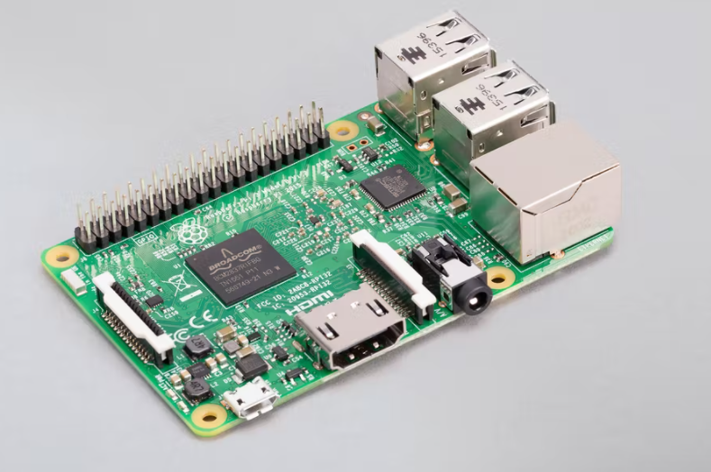
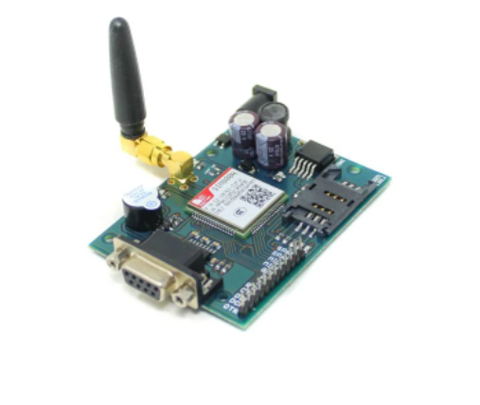
SYSTEM SPECIFICATIONS/TECHNOLOGY
Hardware Requirements
Hardware | Minimum Requirements
Computer | 4 GHz minimum, multicore-core processor
Raspberry Pi | Raspberry Pi 4 Model-B with 8GB RAM
GSM Module | SIM900A Modem is built with Dual Band GSM
USB Cable | Power/Charging, Data Transfer, Connector-A: 1 x USB (Type-A) Connector-B: 1 x USB (Type-C)
Web Camera | Quantum 720p Web Camera
Raspberry pi
GSM Module

Slide 13
SYSTEM SPECIFICATIONS/TECHNOLOGY
Software Requirements
Software | Minimum Requirements
VNC Viewer(OS Compatibility) | VNC Viewer is used for local computers and mobile devices you want to control from.
Python programming language | Python is modest, easy to learn. It is required for the programming of code related to raspberry Pi.
Email | Electronic mail (email) is a method of exchanging messages ("mail") between people using electronic devices.
SMS | SMS stands for Short Message Service and is commonly known as texting.
Browser Support | Application supports all popular browsers.

Slide 14
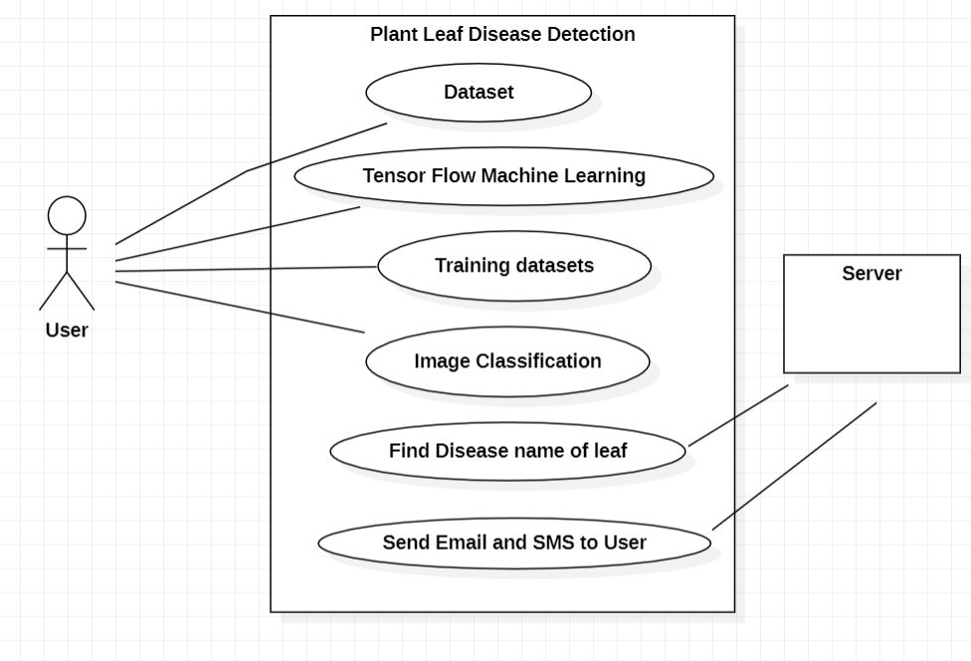
USE CASE DIAGRAM

Slide 15
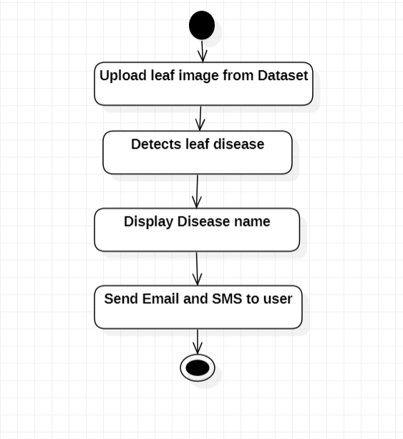
ACTIVITY DIAGRAM

Slide 16
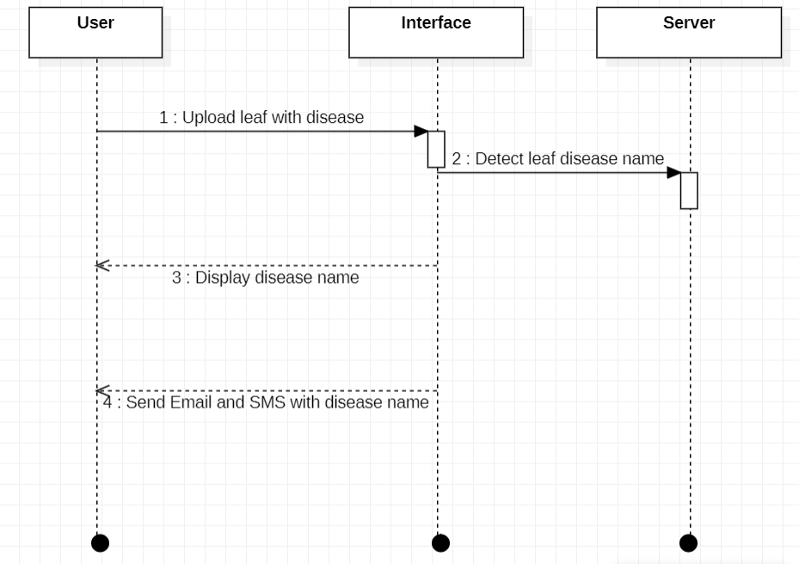
SEQUENCE DIAGRAM

Slide 17
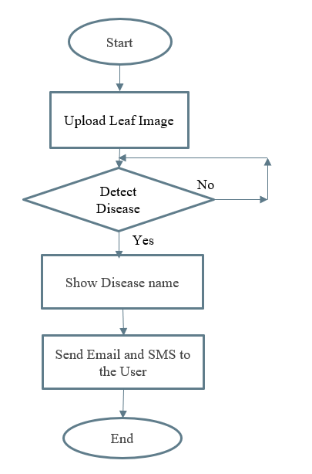
FLOW DIAGRAM

Slide 18
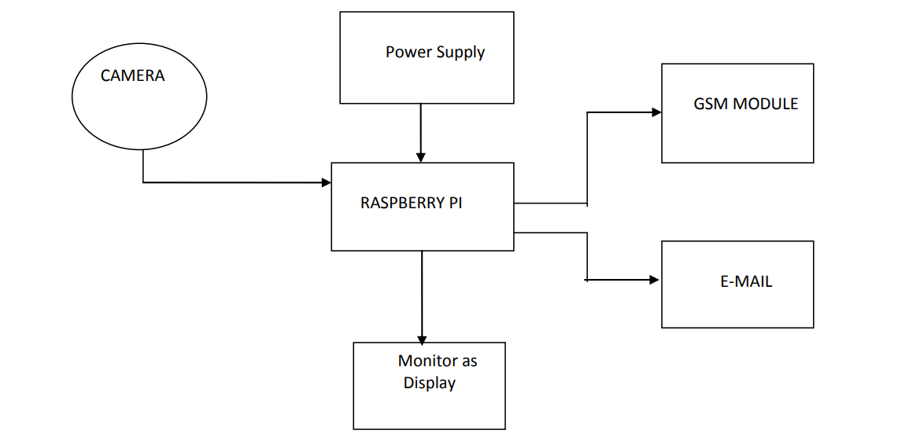
ARCHITECTURE DIAGRAM

Slide 19
DATASET DESCRIPTION
Dataset is taken from Kaggle.
There were many unique classes of disease in the sample. Tomato leaves and corn leaves of four types and nine types of leaf infected images are considered.
We used leaf infected disease photo to identify the disease name.
Preparing the dataset was the first stage in processing the existing dataset.
The Convolutional Neural Network process was used during this step as image data input, which eventually formed a model that assessed performance.
CNNs are used for a variety of tasks in computer vision, primarily image classification and object detection. The open source TensorFlow framework allows to create highly flexible CNN architectures for computer vision tasks.

Slide 20
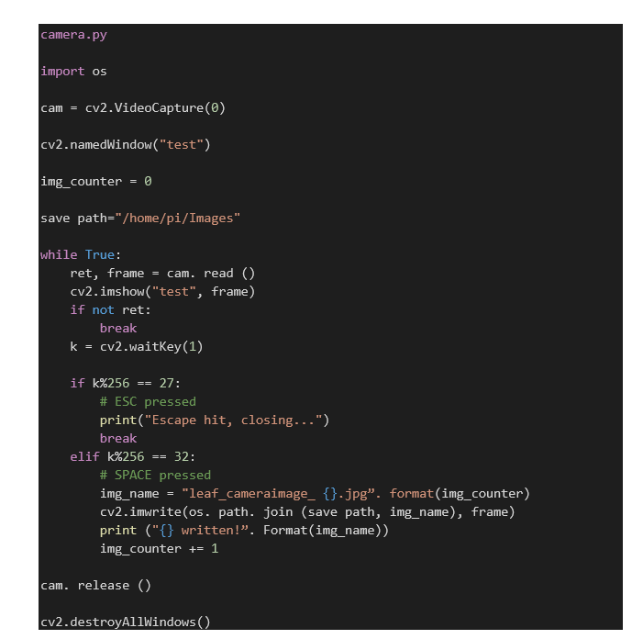
CODE

Slide 21
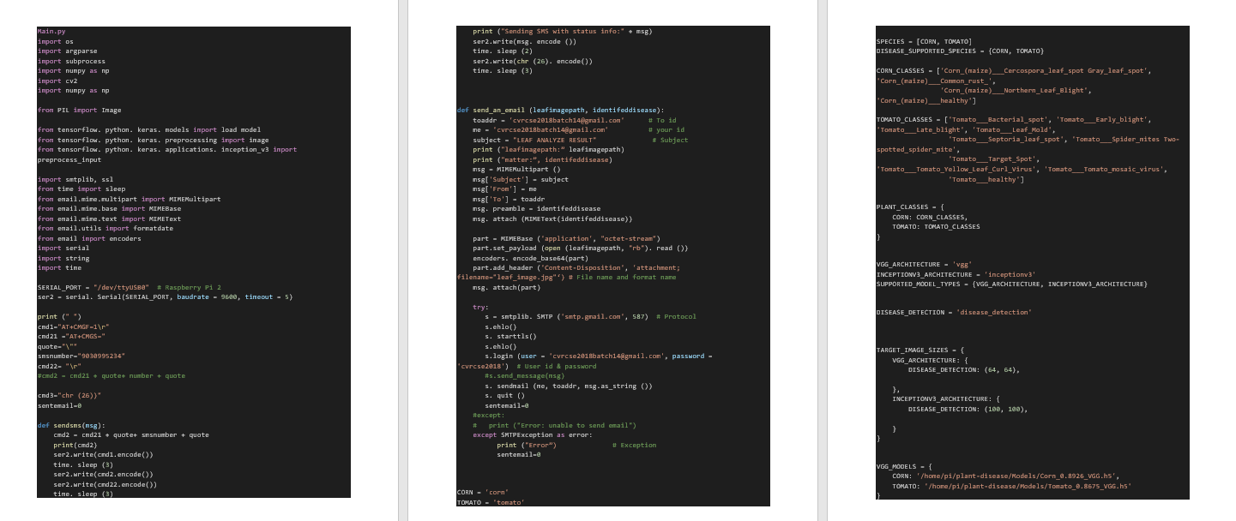

Slide 22
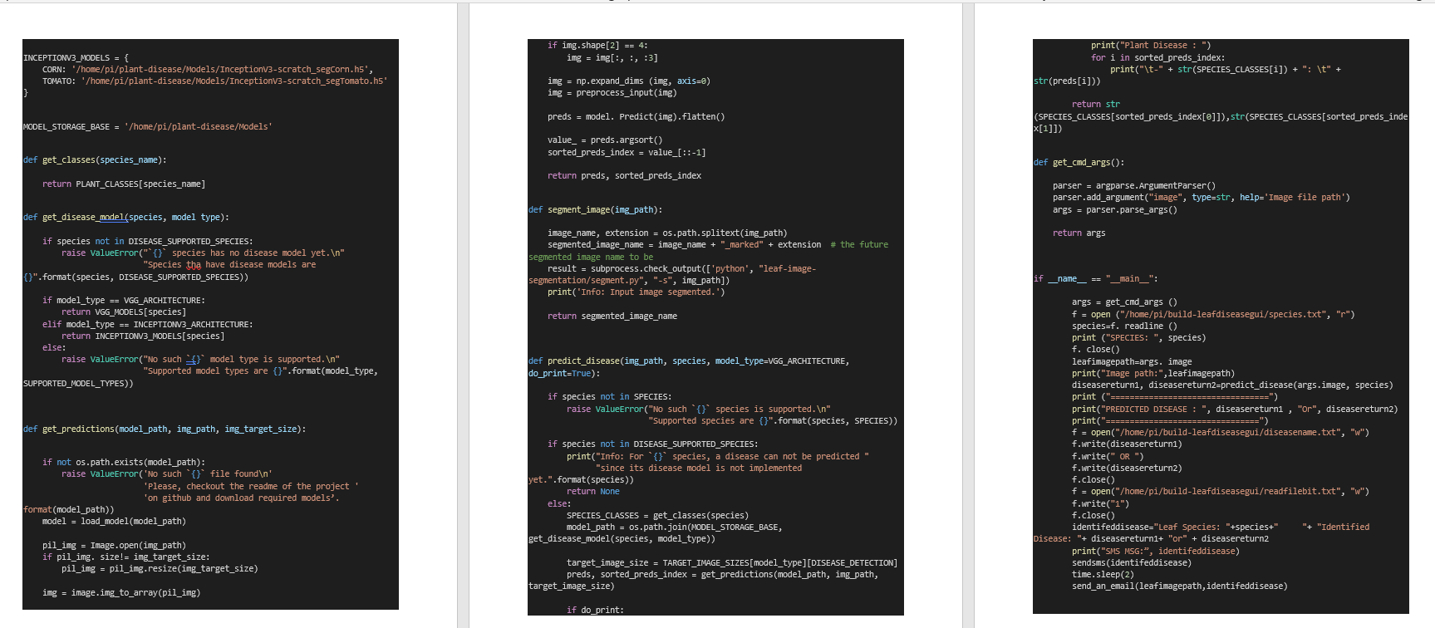

Slide 23
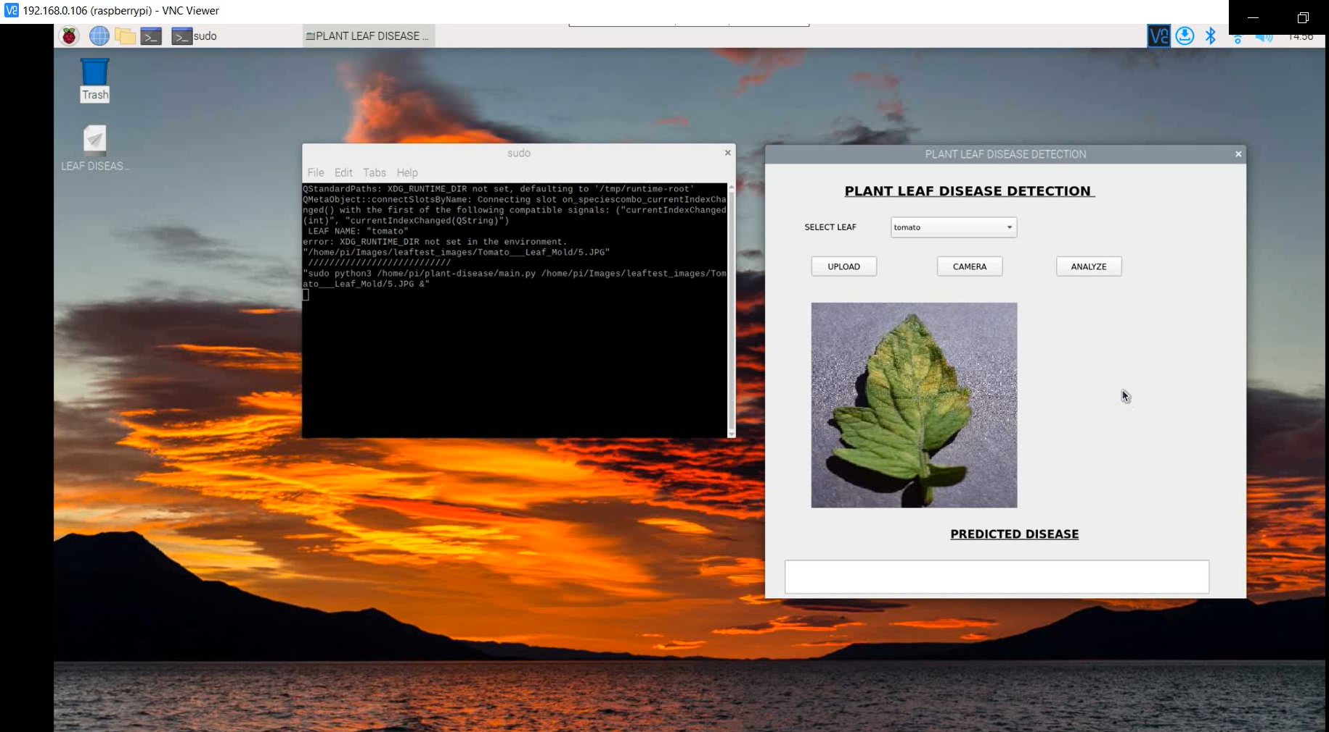
OUTPUT (PLANT LEAF DISEASE DETECTION)

Slide 24
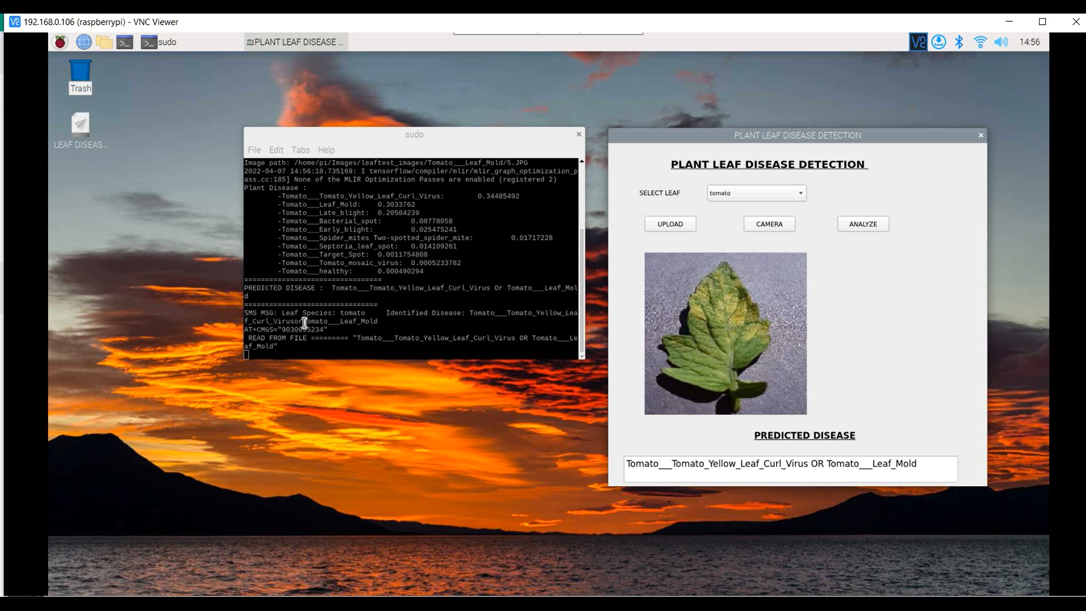
OUTPUT

Slide 25
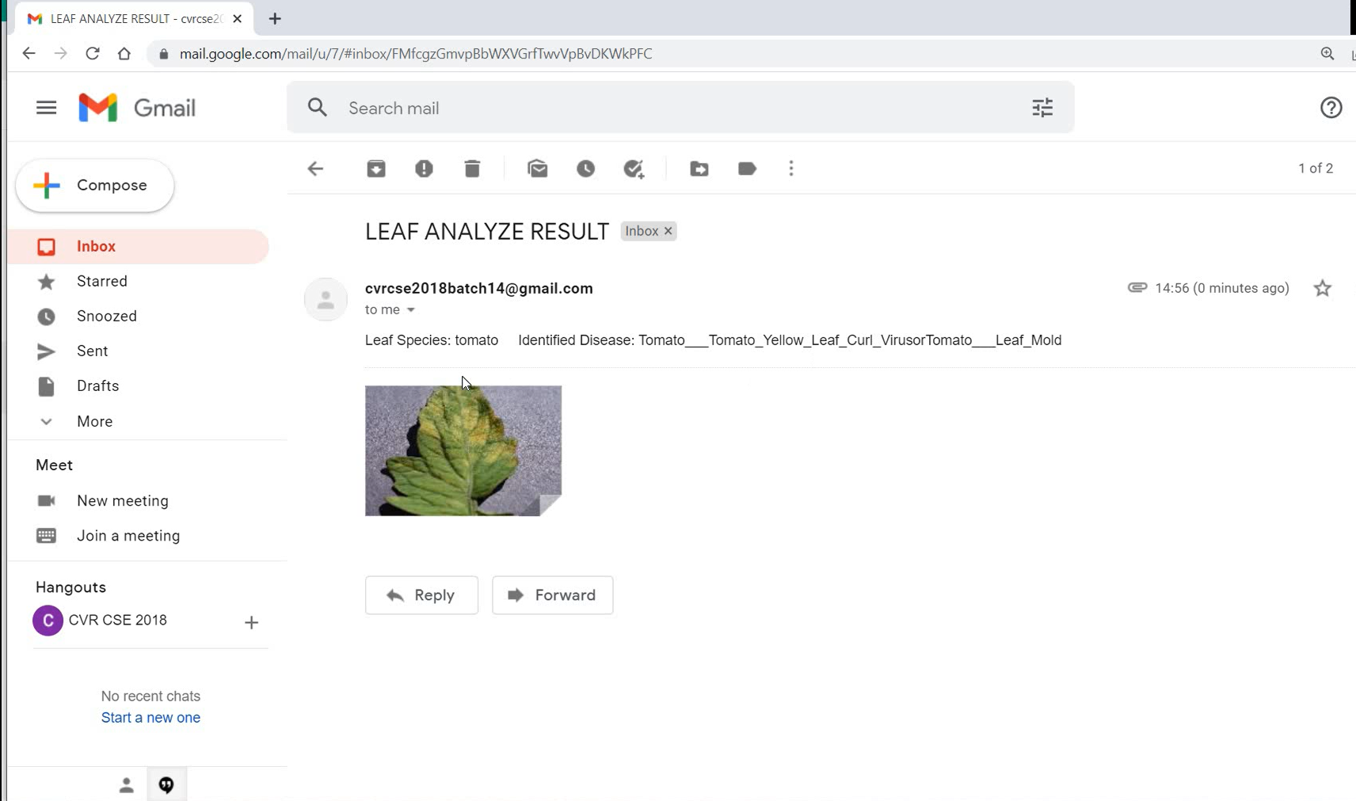
OUTPUT(EMAIL)

Slide 26
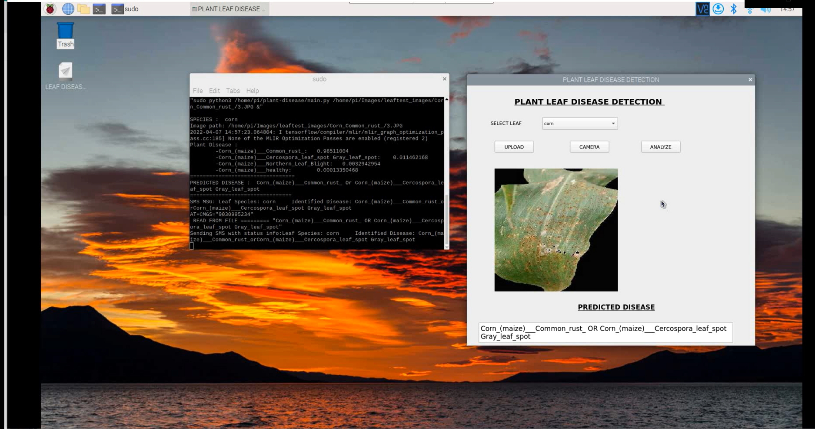
OUTPUT

Slide 27
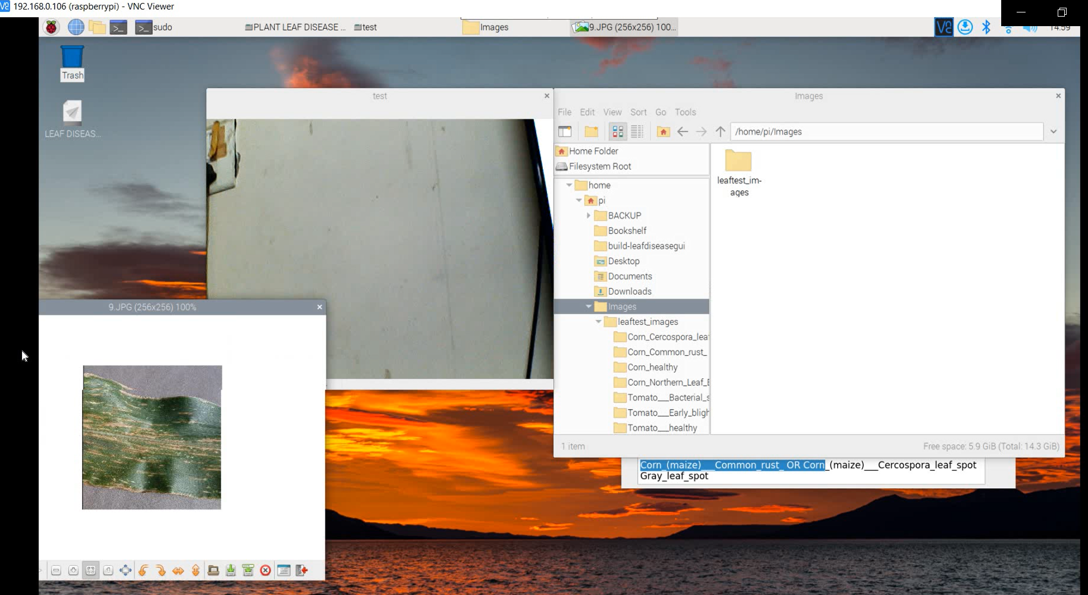
OUTPUT

Slide 28
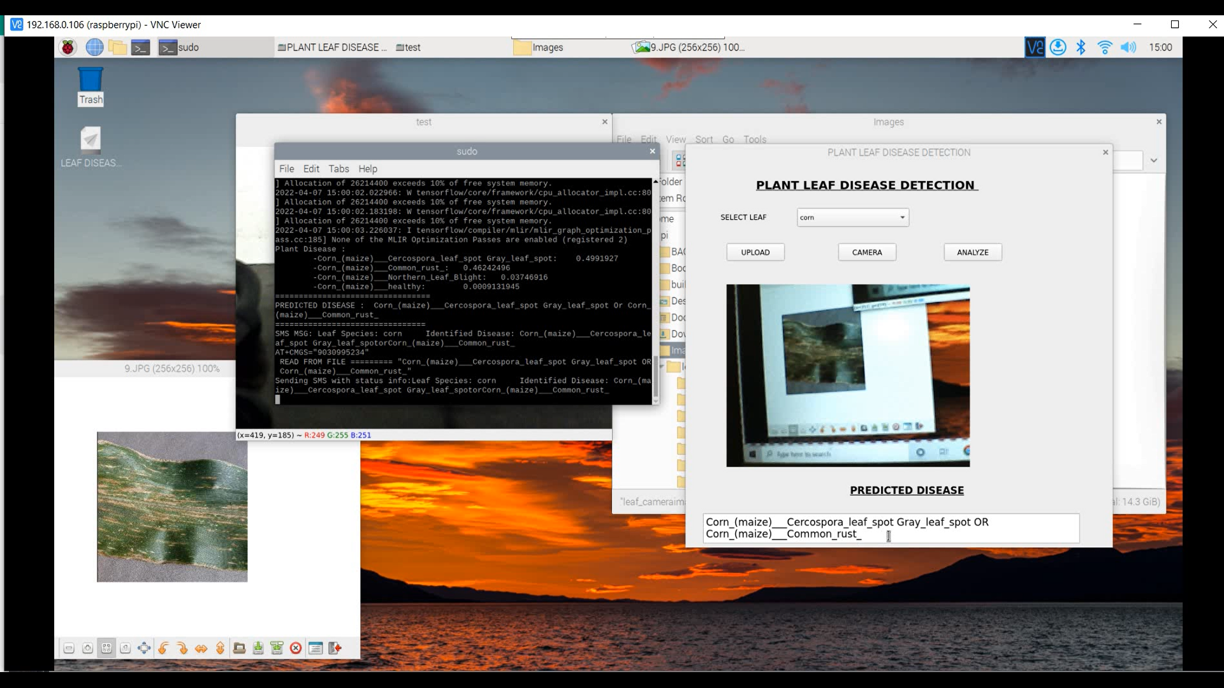
OUTPUT

Slide 29
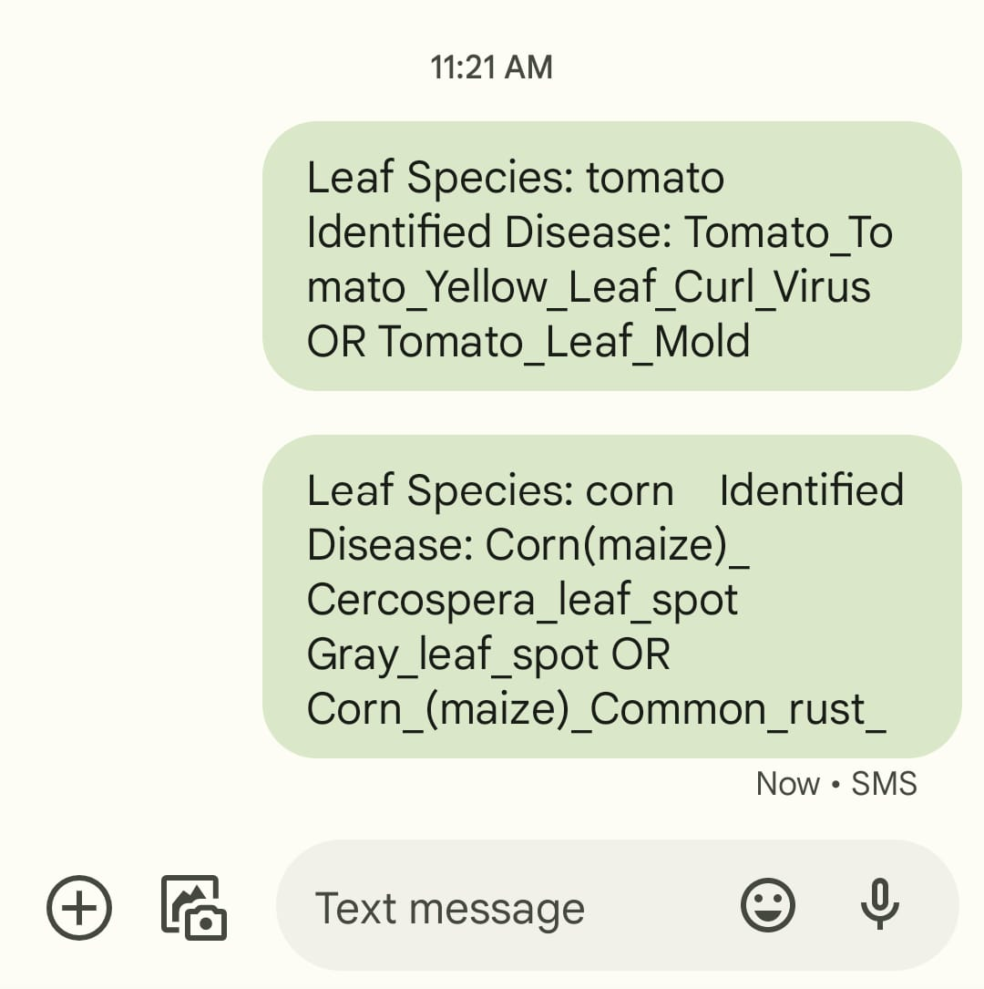
OUTPUT(SMS)

Slide 30
CONCLUSION
We have developed an Application that is integrated with Web Camera to detect and Communicate directly to the farmer seamlessly.
To increase the speed and accuracy of detection as well as classification of leaf diseases we are using Raspberry pi 3 model B module.
This system will largely contribute in growth in the yield of the farms.

Slide 31
FUTURE ENHANCEMENTS
The Process Workflow is dependent on the hardware used and can be enhanced.
The Disease Detection is limited to the data created, can be made exhaustive in the future.
The Scope of the project can be increase to the other plant leaves.

Slide 32
Action Plan
Serial Number | Activity | Planned Start Date | Planned End Date | Current Status | RAG Status
1 | Problem Statement | 10-02-2022 | 12-02-2022 | Completed
2 | Brain Storming for a Solution | 05-02-2022 | 12-02-2022 | Completed
3 | High Level Design | 11-03-2022 | 23-03-2022 | Completed
4 | Coding | 25-02-2022 | 26-03-2022 | Completed
5 | Testing and Deployment | 25-03-2022 | 27-04-2022 | Completed

Slide 33
REFERENCES
M. Reyalat, Al Hiary, Bani Ahmad, Braik and Z. Rahamneh, “Fast and Accurate Detection and Classification of Plant Diseases”.
Smith J S., Camargo A., “An image processing based algorithm to automatically identify plant disease visual symptoms”.
Stilwell, M. The Global Tomato Online News Processing in 2018. Available online: https://www.tomatonews.com/ (accessed on 15 November 2021).
Yu, J.; Wang, J.; Leblon, B. Evaluation of Soil Properties, Topographic Metrics, Plant Height, and Unmanned Aerial Vehicle Multispectral Imagery Using Machine Learning Methods to Estimate Canopy Nitrogen Weight in Corn. Remote Sens. 2021, 13, 3105.
Xie, Q.; Wang, J.; Lopez-Sanchez, J.M.; Peng, X.; Liao, C.; Shang, J.; Zhu, J.; Fu, H.; Ballester-Berman, J.D. Crop height estimation of corn from multi-year RADARSAT-2 polarimetric observables using machine learning. Remote Sens. 2021, 13, 392.

Slide 34
THANK YOU

